Slide 1
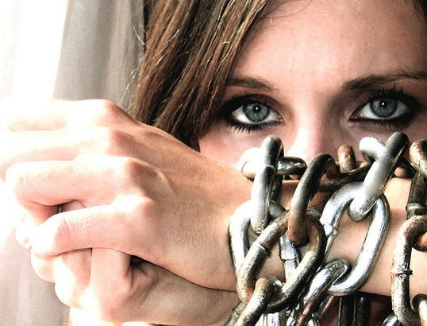
human
trafficking

Slide 2
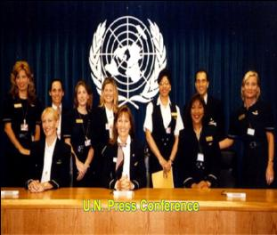
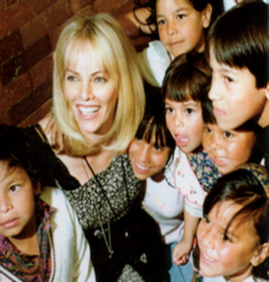
Airline Ambassadors International
A unique model of employee initiative and engagement
A U.N. registered NGO - non governmental organization –
Only independent relief and development charity of the airline industry
Begun by airline personnel using pass privileges to assist children.
Over 6,000 members.
Notes:
2

Slide 3
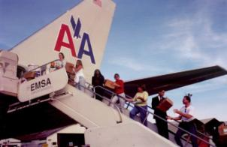
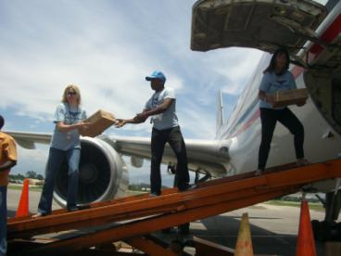
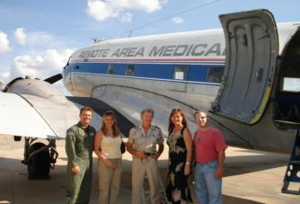
Leverage Airline Connections to Help Children
To provide humanitarian assistance for orphans and vulnerable children.
Expanded to members of all ages and professions.
Members from 12 major airlines
$60 M in aid to54 countries
Notes:
3

Slide 4
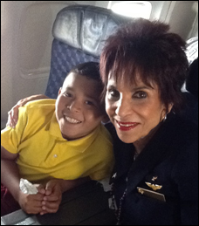
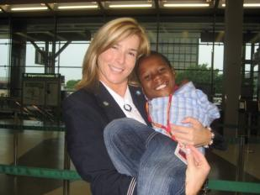
Members Escort Children in Need
.
Over 3,000 children have been escorted for life changing medical care.

Slide 5
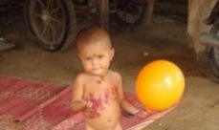
On Humanitarian missions each month
we see Children in Need
In 2009 Learned about issue of Human Trafficking and decided to get involved.
Notes:
5

Slide 6
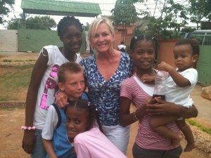
AAI Dominican Republic Mission 10/09
Our team correctly identified trafficking on every flight out!
NO AIRLINE IS EXEMPT

Slide 7
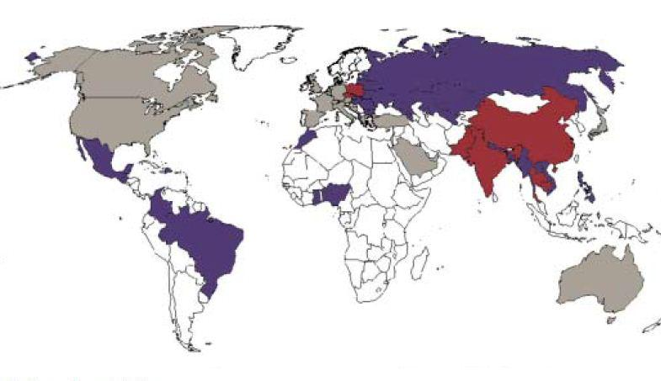
AAI researched the issue and learned human trafficking occurring: All over the world
Affluent countries drive demand - victims are trafficked from poorer to wealthier countries.
Airline Ambassadors International
Destinations
Origins
Both
Notes:
UNODC

Slide 8
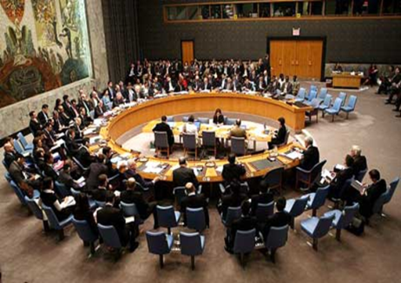
U. S. signed United Nations
Palermo Protocol in 2001
\
“prevent the means of transport by
commercial carriers from being used in commission of (trafficking) offenses.”
(117 countries signed)
© Airline Ambassadors International
Notes:
Figures from UNICEF
8

Slide 9
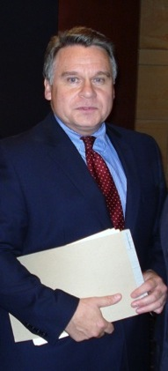
When did the U.S. get involved?
In 2000 Congressman Chris Smith authored
Trafficking Victims Protection Act
Prevent human trafficking
• Protect victims and help them rebuild their lives.
• Prosecute traffickers
Partnerships
© Airline Ambassadors International
Notes:
Figures from UNICEF
9

Slide 10
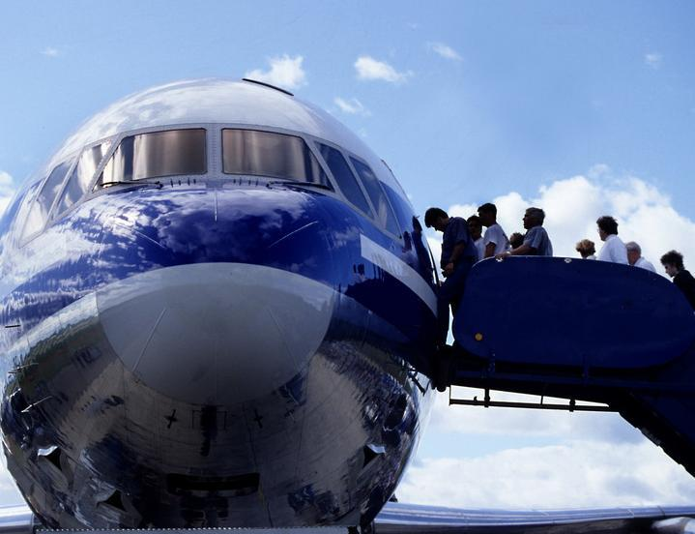
Traffickers Use
Commercial Air Travel
Thousands of victims are transported
across global borders every year.
© Airline Ambassadors International

Slide 11
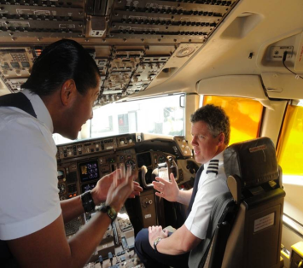
Airlines provide Emergency Procedure Training annually for flight crew
A simple procedure to report potential trafficking on flights
could stop thousands of traffickers and save thousands of victims.
© Airline Ambassadors International
Training could be provided at virtually no cost.

Slide 12
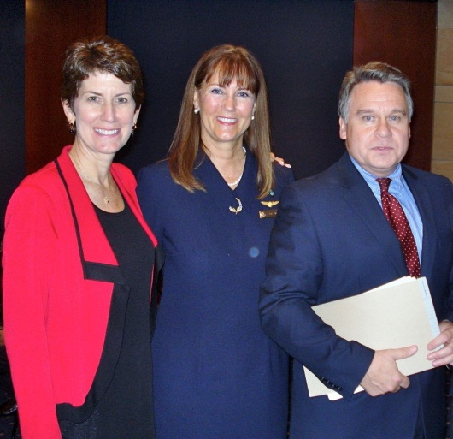
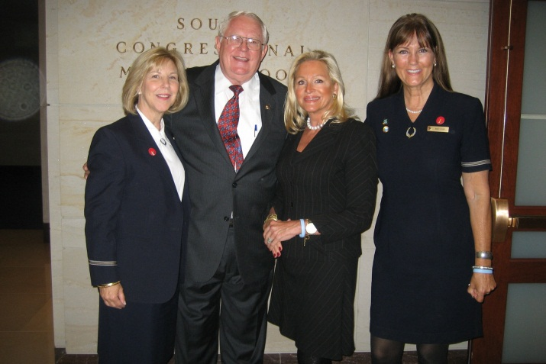
ght
AAI coordinated two Congressional Briefings encouraging airlines to:
Educate Flight Crew
© Airline Ambassadors International
Flight Attendant Bulletin American Way Article

Slide 13
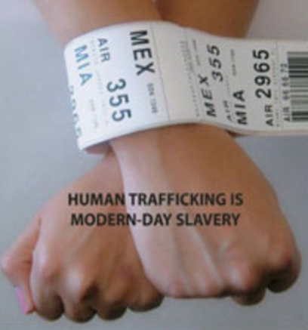
AAI developed industry specific training on Human Trafficking Awareness
Airlines – Airports – Hotels
Reviewed with State Dept., Homeland Security, Customs Border Protection, OAS, etc.
Airlines - large corporate machines. U.S. airlines are just this year putting proper protocols in place.
© Airline Ambassadors International

Slide 14
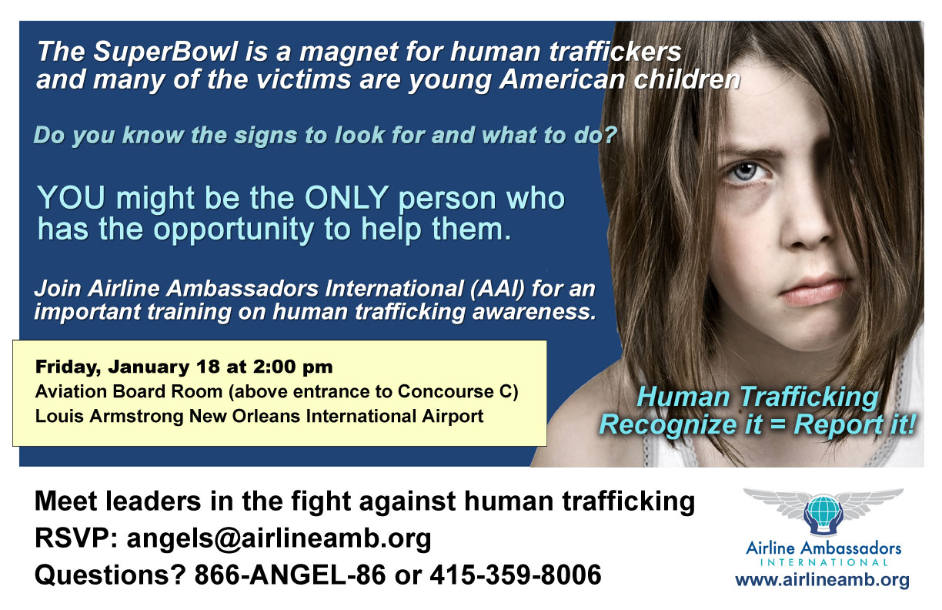
Began volunteer Airport Trainings pre Super-Bowl Jan 2011
Distributed 10,000 wallet cards to flight crews
Support of flight attendant unions 90,000 flight crew
© Airline Ambassadors International
Notes:
Content from previous AAI presentations

Slide 15
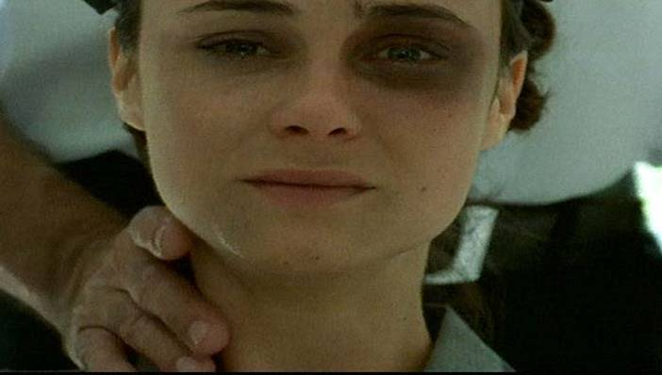
Sample slides from AAI
Training on Human Trafficking
© Airline Ambassadors International
Photo Credit: UNODC

Slide 16
human
trafficking
is SLAVERY

Slide 17
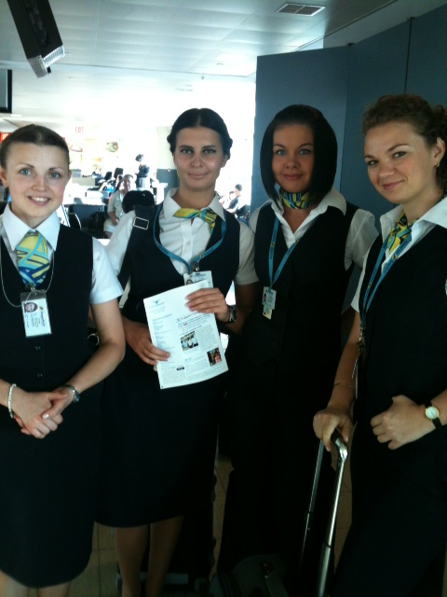
Why Does the Airline/Travel Industry Need Training?
Airline and airport personnel are in a unique position to detect and discern human trafficking situations.
© Airline Ambassadors International

Slide 18
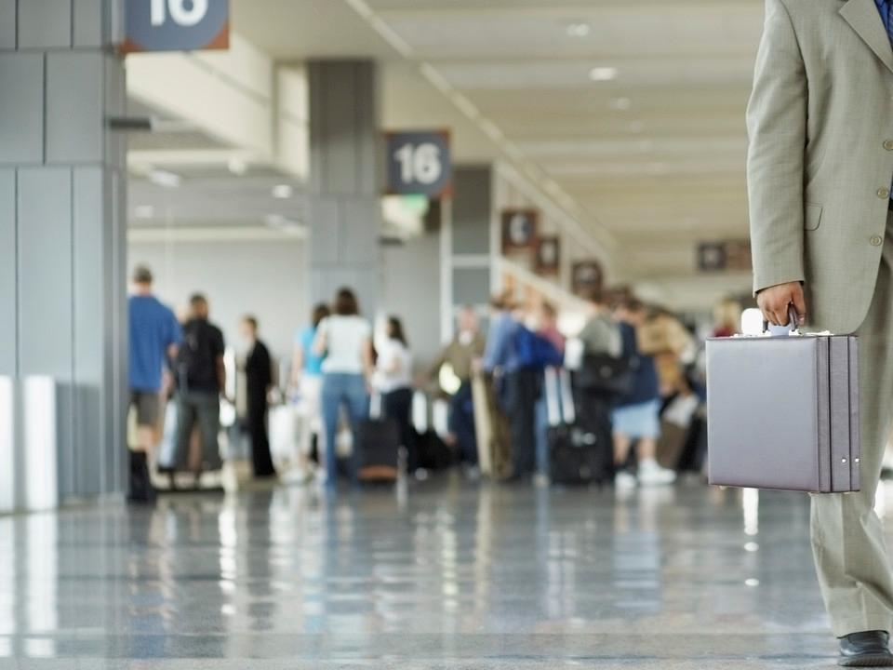
Traffickers Use
Commercial Air Travel
Busy airports are natural distribution hubs for human trafficking.
© Airline Ambassadors International

Slide 19
Who can help?
All airport personnel are in a unique position to detect & discern possible human trafficking situations as well as
Business Travelers who fly frequently
© Airline Ambassadors International

Slide 20
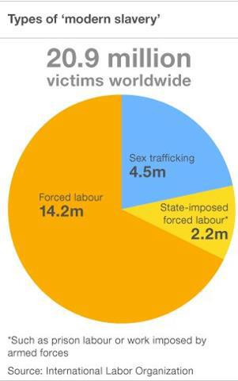
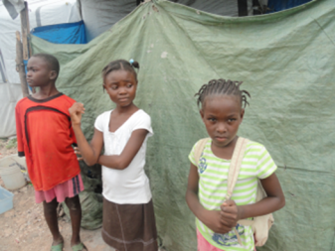
Modern Slavery 2014 study by International Labor Organization $150 BILLION
business!
© Airline Ambassadors International
Notes:
Figures from UNICEF
20

Slide 21
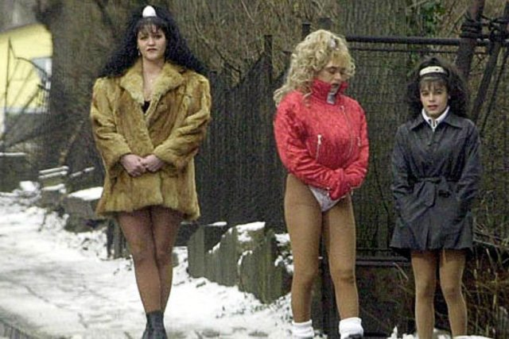
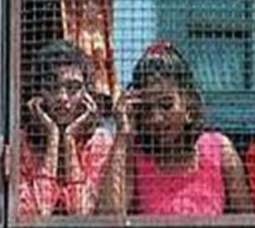
Traffickers see people as commodities…
Renewable sources of income
Often “rented” or sold to paying customers
…and exploit their vulnerabilities
Forcing or tricking people into bondage
Robbing people of their identity and travel documents
© Airline Ambassadors International

Slide 22
What Common Tactics Do Traffickers Use?
Luring victims
Love, jobs, a better life
Internet- facebook social networking
Abducting/detaining victims
Violence
Drugs
Transporting victims
Airlines
Buses – trains - boats
© Airline Ambassadors International
Notes:
Information from previous AAI presentations

Slide 23
Why Don’t Victims Escape?
Don’t know their location
Moved often to avoid forming relationships and attracting attention
Told families will be harmed
Don’t know the language
The Stockholm Syndrome
© Airline Ambassadors International
Notes:
Information from previous AAI presentations

Slide 24
Impact on the Victim
Physical Damage
Infectious diseases Permanent scarring from cigar and cigarette burns
Internal physical damage
Unset broken bones
Malnourishment
© Airline Ambassadors International
Notes:
Petra… now your can introduce Debra and if you could talk a little about Deb finding and recued Somnang in Cambodia which started AAI involvement

Slide 25
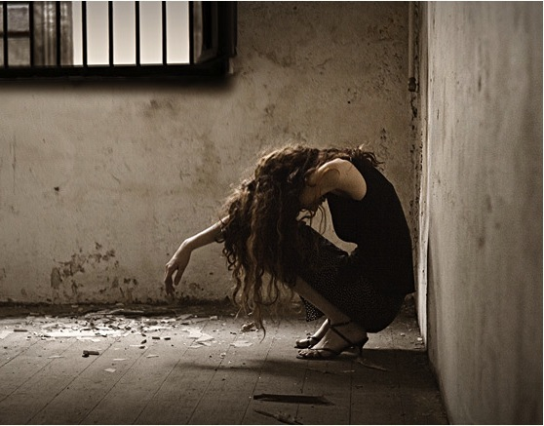
Long Term Psychological Damage
Post-Traumatic Stress Disorder
Substance abuse
Eating disorders
Suicidal thoughts
Self-hatred
May break physical chains, but psychological chains remain for 15-20 yrs.
Notes:
I heard a quote this afternoon on NPR (so it must be true) that there are more “slaves” today than when William Willberforce was crusading almost 200 years ago. Slavery isn’t gone, it’s only taken on a different form. I’m sure you can verify that without much trouble. A great footnote in the Handbook, to quote the source of the stats.
We’re doing this so that…
So that young lives are not stolen…
So that…
You could finish this with something positive like a bunch of beautiful smiling kids, but I think something cold and dark like this will stick with people. It’s a haunting image they will not forget. Brings the whole thing into perspective.
And, Tony Campolo says guilt is a great motivator – just don’t pour it on too thick
You have some good points about what impact trafficking and slavery have on lives. You can probably save a lot of that for later.
This could be the place for your slide # 7- 8
We as Airline and Airport personnel are in a unique position as a front line of defense, playing a critical role - to detect and discern, (as eyes and ears) identifying suspect trafficking situations in this global fight.
Some thoughts…
Be a little careful with your transitions – it’s good to have variety but not too much otherwise people get distracted from your message, wondering which one you’re going to do next. You don’t want to be totally boring, but you don’t want them doing the guessing game about the next transition instead of paying attention to you. I’d just fade to your title slide.
Don’t know if your version of ppt can time transitions between slides and for images to appear – I made some of these long to make them thought provoking. You’ll have to time out your “speech” to see how comfortable you are with the transition time – for this, I like longer…I think more engaging.

Slide 26
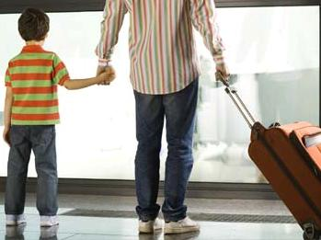
What are the indicators of a Victim?
What Should You Do
At the Airport
Afraid of uniformed security
Unsure of destination
Frightened, ashamed, or nervous
Scripted stories (answers seem rehearsed and inconsistent
Wearing inappropriate clothing
and/or overall appearance does
not fit route of travel, weather.
Claims of being an adult but appearance indicates adolescent features
© Airline Ambassadors International

Slide 27
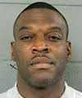
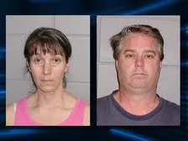
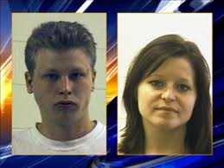
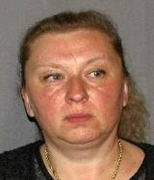
Who are Traffickers?
Female or male, young or old, citizens or foreign nationals
Stranger to victim, family member, acquaintance or an intimate partner.
member of organized crime or gang.
© Airline Ambassadors International
Human Traffickers can be ANYONE
willing to exploit another for profit
Notes:
Consolidated content from previous AAI presentations

Slide 28
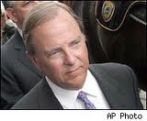
How to Spot Traffickers
May answer questions for victim
Observe victim persistently
Gives evasive answers
May not know child’s name or personal information
Poses as a relative
Flight attendants have correctly assessed trafficking situations with each of these indicators.
© Airline Ambassadors International
Notes:
Consolidated content from previous AAI presentations

Slide 29
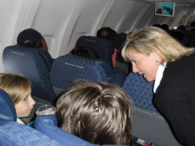
What Can You Do
As Flight Crew or ground personnel
Ask Be observant of passengers, especially children and young women traveling alone
Note who accompanies them and if someone controls their movement
Initiate pleasant, non-threatening conversation
© Airline Ambassadors International

Slide 30
What You Do “Blue Lightening Protocol”
Evaluate circumstances – Radio upcoming airport
Provide information to DHS Tip Line 866.347.2423 (Intl.# 802.872.6199)
National Human Trafficking Resource Center NHTRC: 888.373.7888
As a backup, call airport police or 911
© Airline Ambassadors International

Slide 31
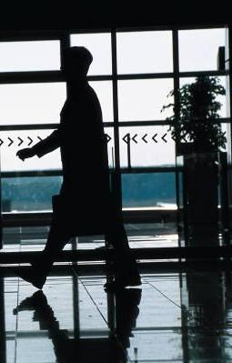
What Should You NOT DO?
Do NOT confront anyone you suspect of engaging in trafficking
Do NOT try to rescue any possible victim
Do NOT display any unusual concern or alarm
Do NOT endanger yourself or others
© Airline Ambassadors International

Slide 32
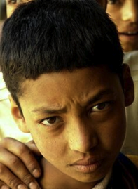
On AA’s daily flight Moscow – Chicago, there were usually 4-5 teenage girls that had been told they were coming to the U.S. to be models or work on TV.
The girls did not
speak English
.
© Airline Ambassadors International
Photo by Kay Chernush
for the U.S. State Department
Photo by Kay Chernush for the U.S. State Department

Slide 33
.
Travel documents had been arranged and their itinerary stated they would have to ride a bus to New York City.
They were trafficked into the sex trade.
.
© Airline Ambassadors International
Photo by Kay Chernush
for the U.S. State Department

Slide 34
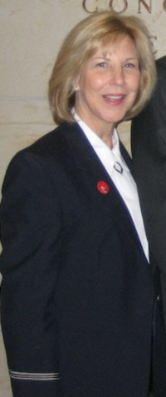
International Flight attendant Sandi Fiorini called the Trafficking Hotline and
an under-cover
Custom’s Agent was assigned to monitor that flight
© Airline Ambassadors International
Photo by Kay Chernush
for the U.S. State Department
Notes:
Story from AAI presentation – With proper training, this scenario could have had a different outcome.

Slide 35
Thank you for support of efforts
To fight human trafficking
Notes:
This problem isn’t just going to go away… only get bigger.
With proper training, we can all play a critical role.
Real action means really reporting and enabling people in that effort.
If we know this crime is happening and do nothing, we not only condone it, but we’re just as guilty as the people doing it to them.
As safety professionals, it’s our JOB to keep our passengers safe. As caring, concerned people, it’s a moral impulse. And we can make a HUGE difference with JUST A LITTLE EFFORT
35

